Slide 1
Dictionary:-
In python

Slide 2
Contents:-
Dictionary in python
Methods to create a dictionary
Accessing elements in a dictionary
Traversing a dictionary
Appending values in a dictionary
Updating elements in a dictionary
Removing a dictionary
‘in’ and ‘not in’ membership operator
•Common dictionary functions and methods

Slide 3
Dictionary in python:-
Dictionaries are Python's implementation of a data structure that is more generally known as an associative array. A dictionary consists of a collection of key-value pairs. Each key-value pair maps the key to its associated value.

Slide 4
CREATING A DICTIONARY:-
Values in a dictionarycan be of any datatype and can be duplicated, whereas keys can't be repeated and must be immutable.Dictionary can also be created by the built-in function dict(). An empty dictionary can be created by just placing to curly braces{}.
Syntax:
<dictionary_name> = {'key1': value1', 'key2': 'value2', 'key3':'value3'.. 'keyn': 'valuen'}

Slide 5
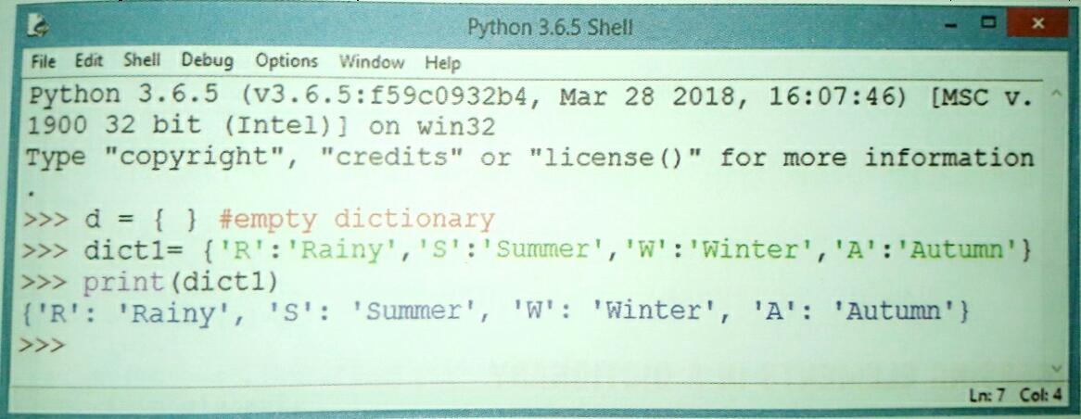
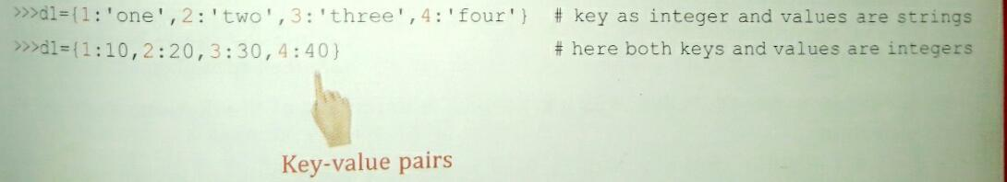
Examples of dictionary:-

Slide 6
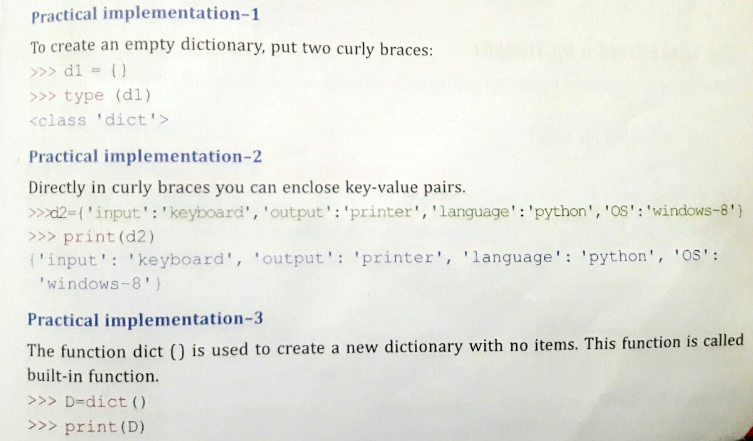
Methods to create a dictionary:-
To create a dictionary, key-value pairs are seprated by comma and are enclosed in two curly braces,{}.In key-value pairs, each key is seprated from its value by a colon [:].

Slide 7
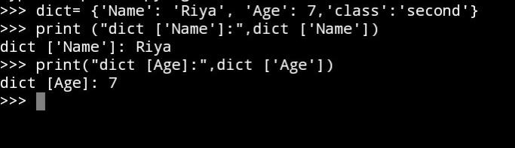
Accessing elements in a dictionary:-
You can access the items of a dictionary by referring to its key name, inside square brackets:Get the value of the "model" key: ...Get the value of the "model" key: ...Print all key names in the dictionary, one by one: ...Print all values in the dictionary, one by one:

Slide 8
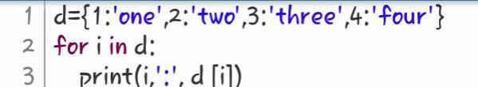
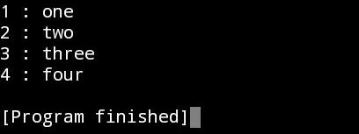
Traversing a dictionary:-
There are two ways of iterating through a Python dictionary object. One is to fetch associated value for each key in keys() list. There is also items() method of dictionary object which returns list of tuples, each tuple having key and value.
In operator using for loop:
Code•

Slide 9
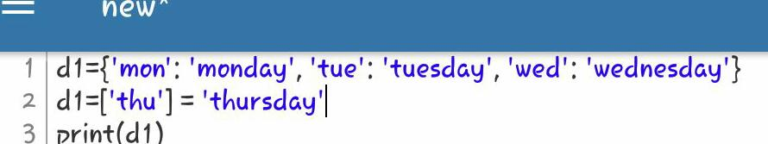
Appending values of a dictionary:-
Append multiple key value pair in dictionary As update() accepts an iterable sequence of key value pairs, so we can pass a dictionary or list of tuples of new key value pairs to update(). It will all add the given key value pairs in the dictionary, if any key already exists then it will update its value..
Syntax-
Dictionary name [key]=value
Example:

Slide 10
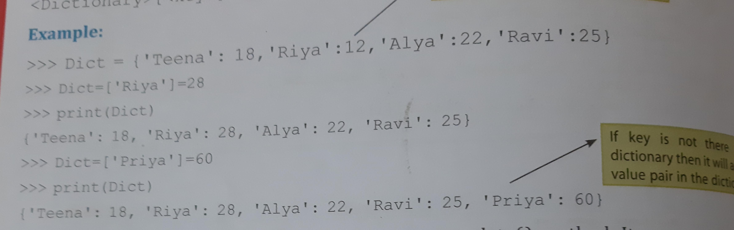
Updating elements in a dictionary:-
The update() method updates the dictionary with the elements from the another dictionary object or from an iterable of key/value pairs. The update() method adds element(s) to the dictionary if the key is not in the dictionary. If the key is in the dictionary, it updates the key with the new value.

Slide 11
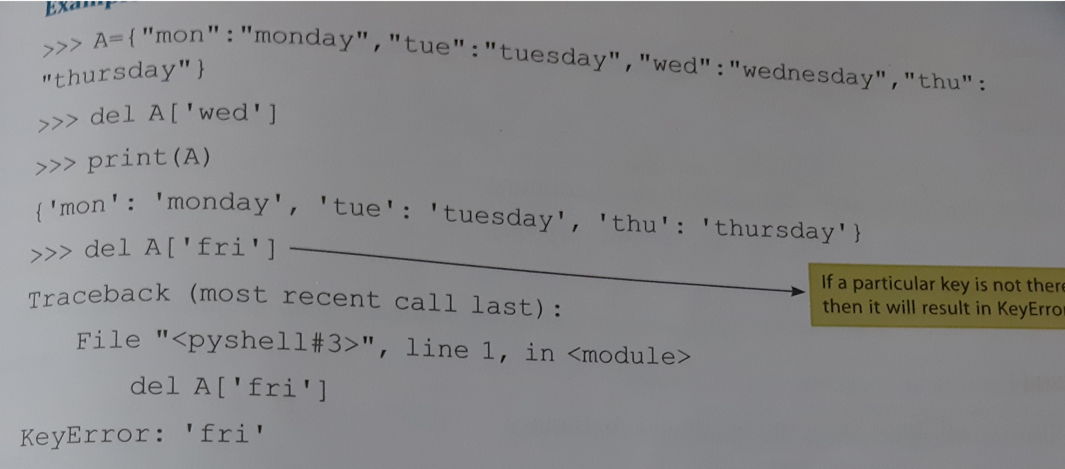
Removing an item from dictionary:-
You can use both dict. pop() method and a more generic del statement to remove items from a dictionary. They both mutate the original dictionary, so you need to make a copy (see details below). Unless you use pop() to get the value of a key being removed you may provide anything, not necessary None .
1st-Using del commands:
Syntax:
del dicname [key]

Slide 12
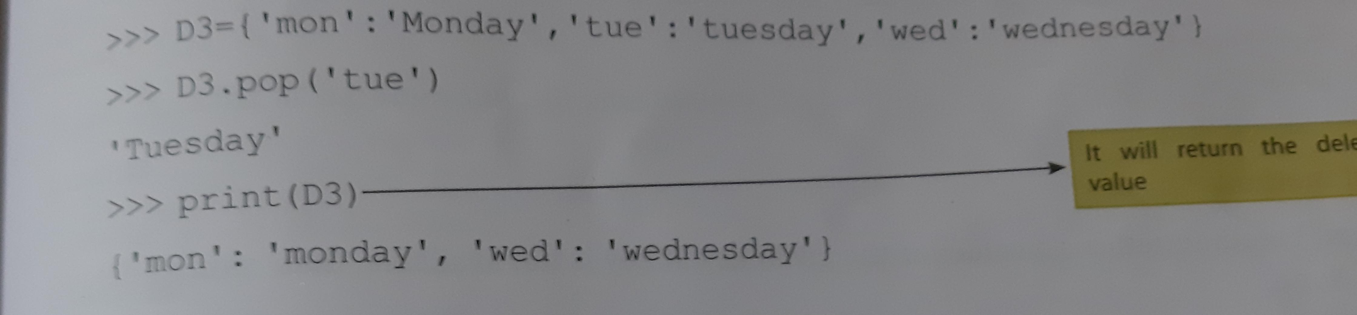
2nd-using pop() method:
Syntax:
Dictname.pop (key)
-- pop() method will not only delete the item from the dictionary,but also return the deleted value.

Slide 13
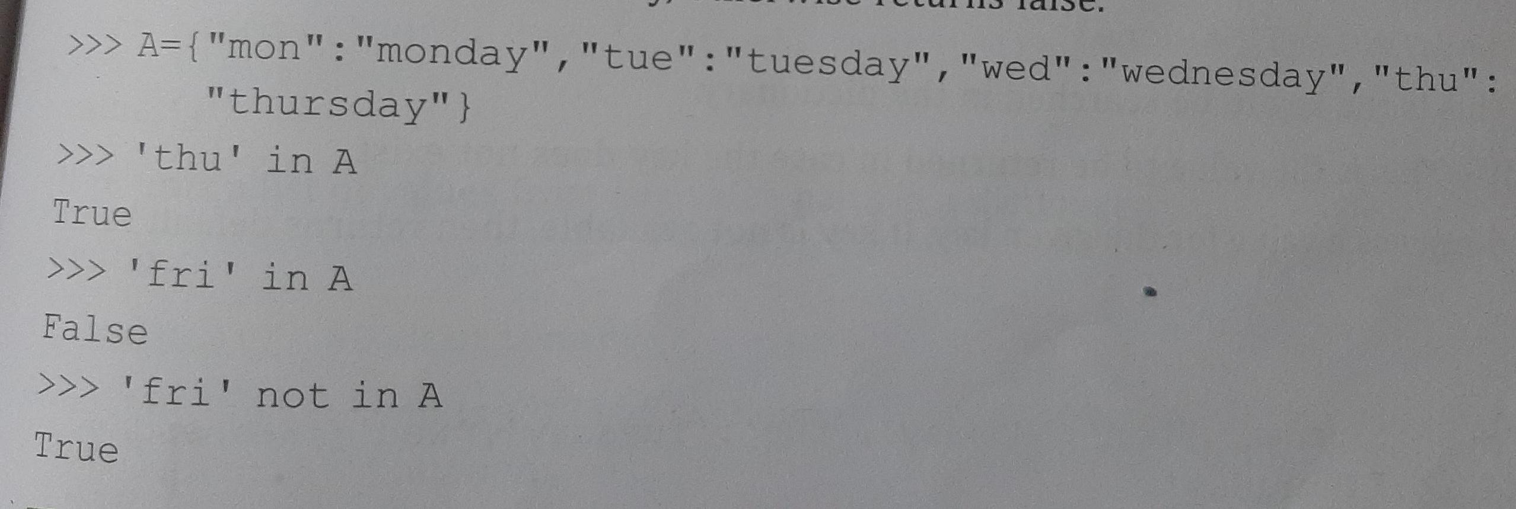
‘In’ and ‘ not in’ membership operator:-
Python Membership and Identity Operators | in, not in, is, is not. Membership operators are operators used to validate the membership of a value. It test for membership in a sequence, such as strings, lists, or tuples. in operator : The 'in' operator is used to check if a value exists in a sequence or not.

Slide 14
Common dictionary functions and methods:-
Get()method
The syntax of get() is:----dict.get(key[, value])
get() Parameters
The get() method takes maximum of two parameters:
key - key to be searched in the dictionary
value (optional) - Value to be returned if the key is not found. The default value is None.
Return Value from get()
The get() method returns:
the value for the specified key if key is in dictionary.
None if the key is not found and value is not specified.
value if the key is not found and value is specified.

Slide 15
Thankyou
-by khushi gupta

